Slide 1
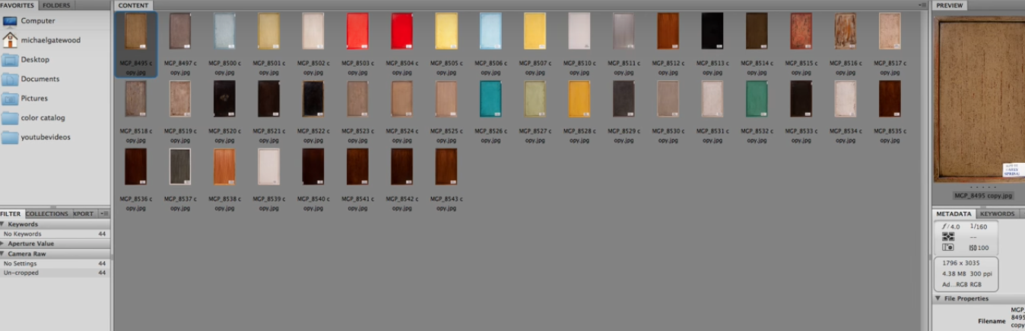
Adding metadata to images using Adobe Bridge
Step 1
Tools- Create metadata template
Step 2
Template Name: WildLife
Creator: Aninda
Description: Herbivores giant wild
Keyboards: Herbivores, giant, wild, elephant, largest, wildlife, safari, Terrestrial animal, natural landscape
Copyright Status: Copyrighted
Save
Step 3
Select all panels
Tools- Replace metadata- choose ‘WildLife’
Step 4 -Illegal copyright and copying is protected
Step 5- This can be used for search through google.com

Slide 2
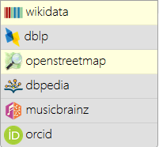
Possible Algorithm
Downloading a collection of images (100-1000) for a given subject. Problem: downloading manually, need to figure out bulk download method
Including metadata to all the downloaded images in ways of adding keywords so that we can just test and find out if images comes up in google search or not, initially by simply using apps like Adobe Bridge.
For Qanswer, we see that it runs queries from the following
If we just try to get the get the images from let’s say wikidata
then, Go to the WikiData entry that you’re interested in.
Eg:Q7378, trunk bearing large mammal
Look under Statements where you’ll see a list of different boxes with different items of information. At the end of the list of statements, you’ll see [add] or add statement. Click here. In the box marked ‘property’, enter ‘image’ or ‘P18’ which is the number code for images. In the box next to this, enter the file name of the image as it appears on WikiCommons e.g.. ElephantsTest (3).jpg Click on ✓ Save to the right of the box.
Customizing metadata using computer vision would be the next course of action

Slide 3
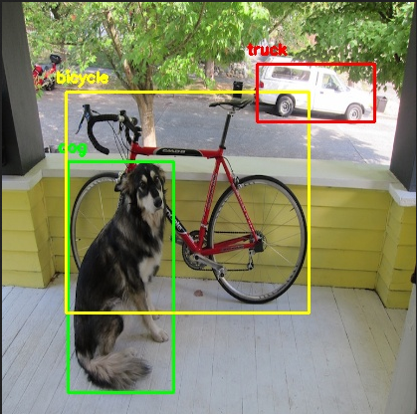
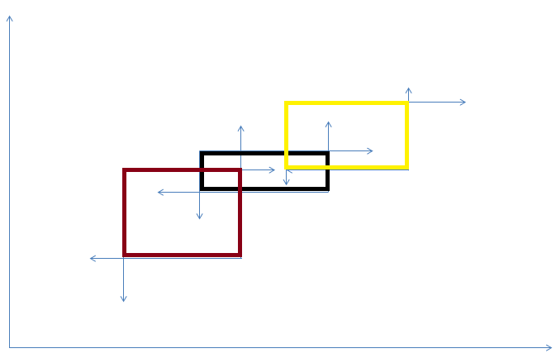
Possible Algorithm for add metadata to images using computer vision api
Let’s consider the following images

Slide 4
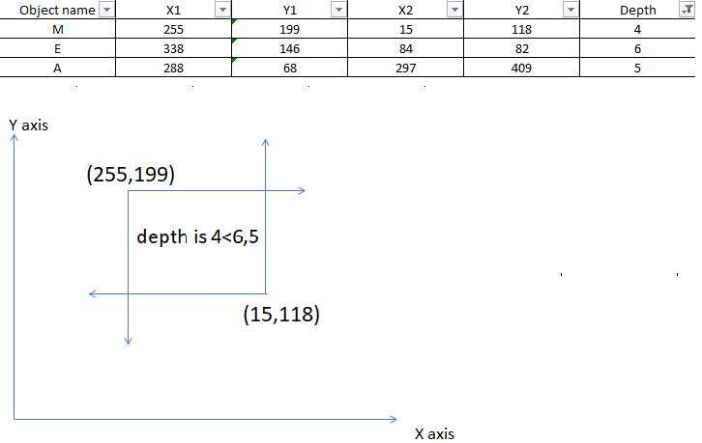
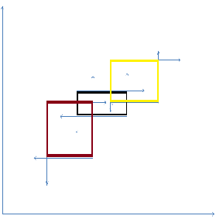
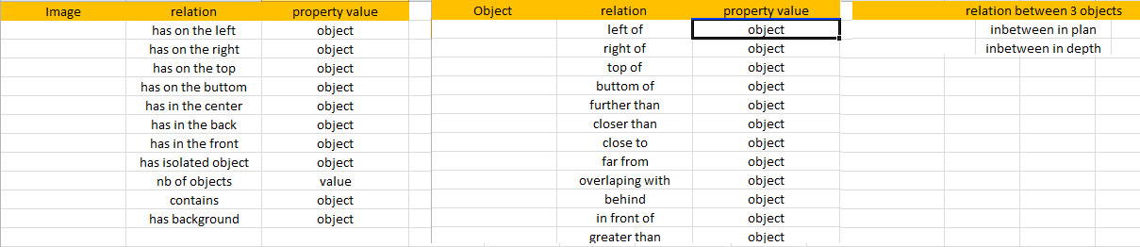

Slide 5
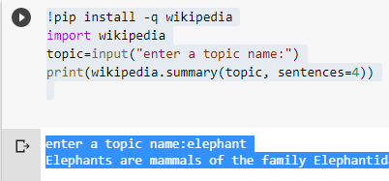
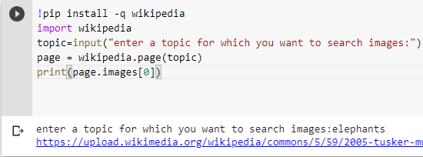
Simple python using Wikipedia api

Slide 6
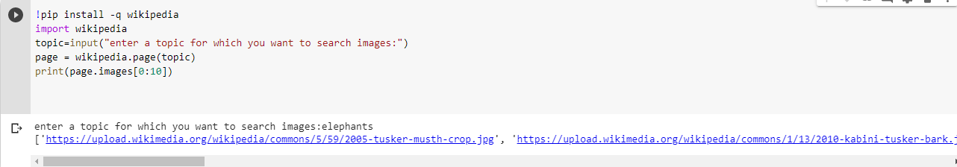
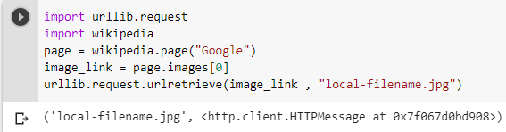
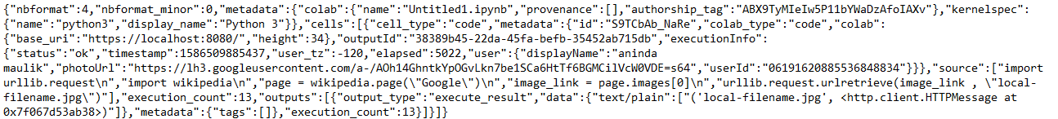

Slide 7
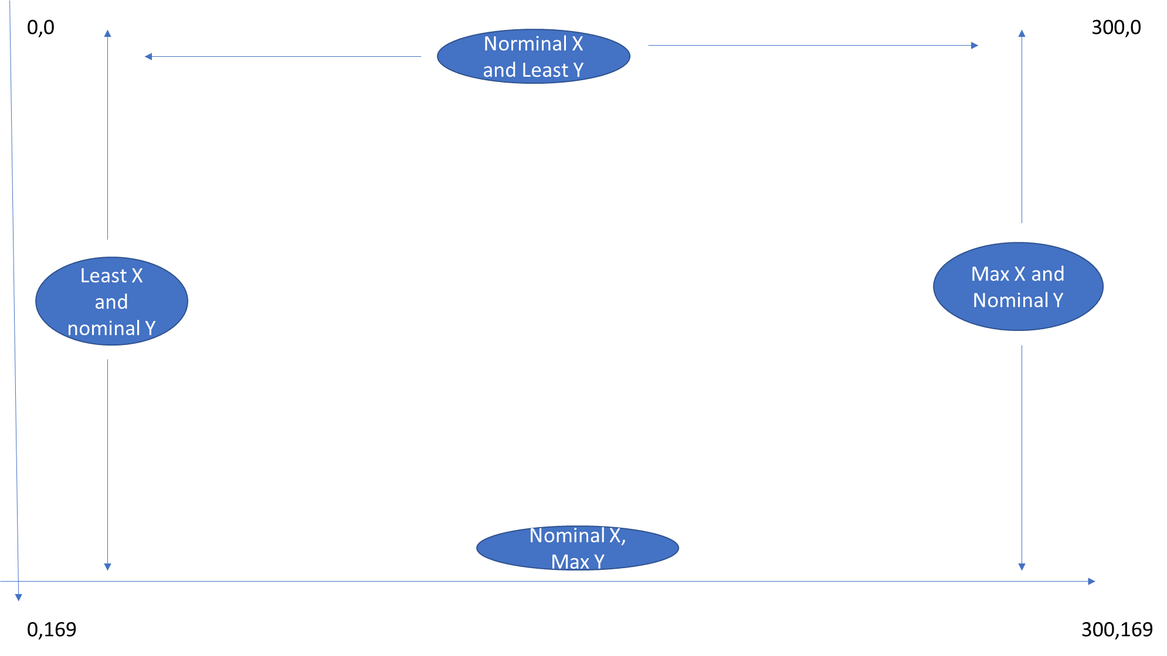
Least Difference between X of centre and Y of centre,with bounding box’s central x,y coordinates

Slide 8


Slide 9
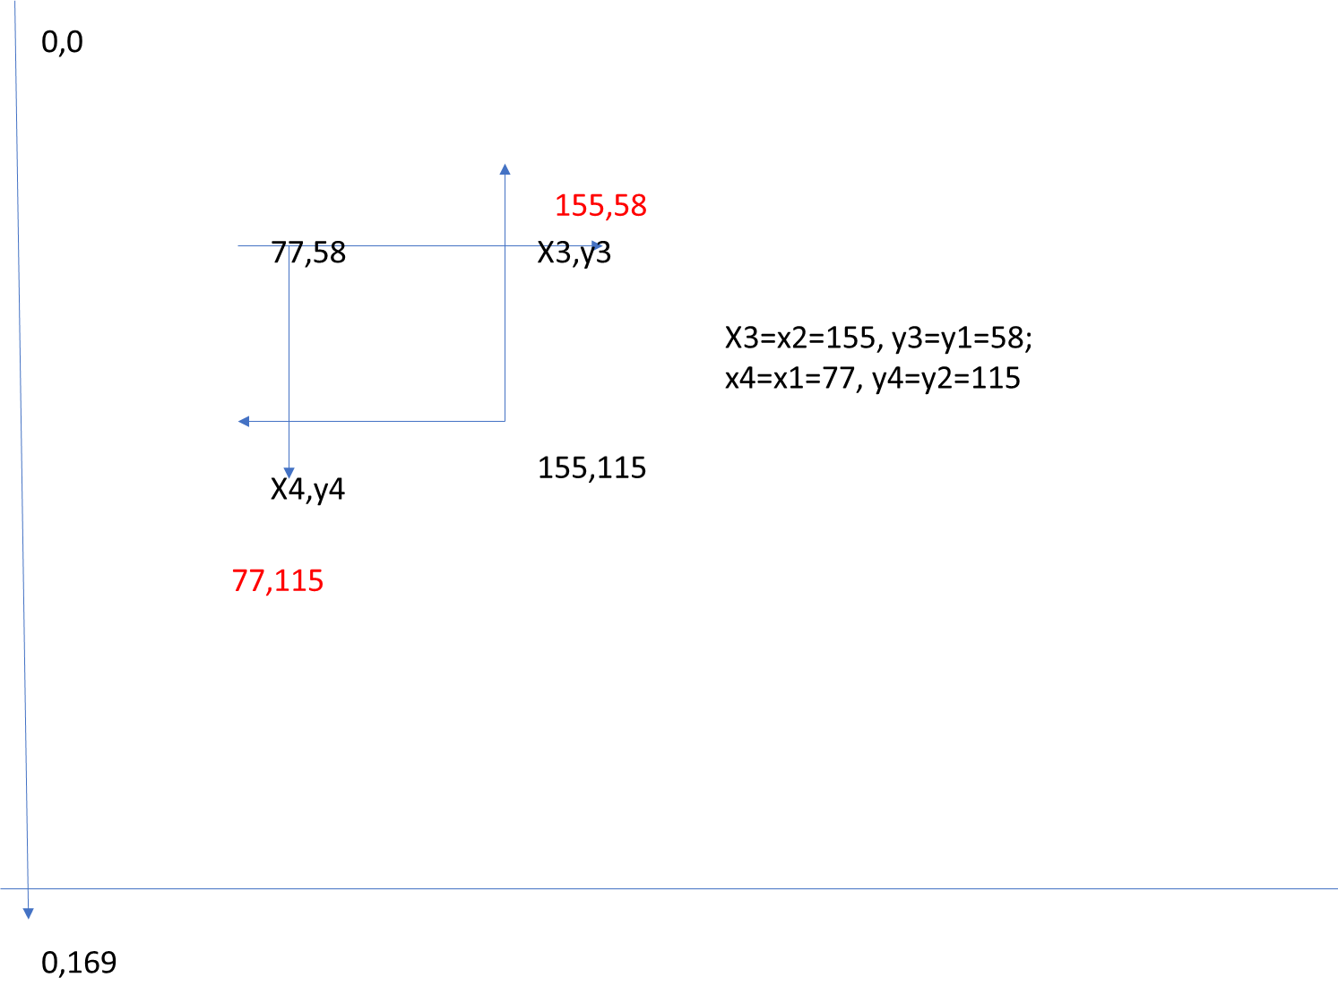

Slide 10
If the end points of a line segment is (x1, y1) and (x2, y2) then the midpoint of the line segment has the coordinates:[(x1+x2)/2,(y1+y2)/2]
https://www.mathplanet.com/education/algebra-2/conic-sections/distance-between-two-points-and-the-midpoint

Slide 11
